Slide 1

Project Group 15
Pose Recognition via Deep Residual Learning
•Project group members
Lei, Deren
Sun, Zichen
•Demo: No
•Embedded Video: No
•Ok to post online: Yes
•Preferred presentation timeslot: Tgroup2;

Slide 2
Dataset: AVA (Atomic Visual Actions)
The AVA dataset is an annotated video dataset.
Our request:
1) Prediction on Static Recognizable Action
Our request:
2) Our model should be more diverse and it should be widely used in multiple situations
Our request:
3) Challenge
AVA’s property:
Precise spatio-temporal annotations for each human;
AVA’s property:
The use of diverse, realistic video material (movies);
AVA’s property:
The lowest mAP (15.6%)
Background:
[1] He, Kaiming et al. “Deep Residual Learning for Image Recognition.” 2016 IEEE Conference on Computer Vision and Pattern Recognition (CVPR) (2016): 770-778.
[2] Murray, Naila et al. “AVA: A large-scale database for aesthetic visual analysis.” 2012 IEEE Conference on Computer Vision and Pattern Recognition (2012): 2408-2415.

Slide 3
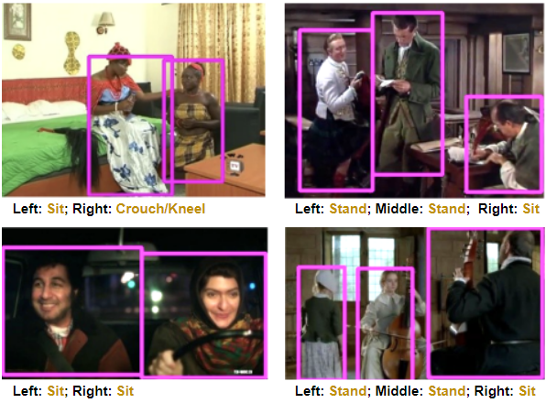
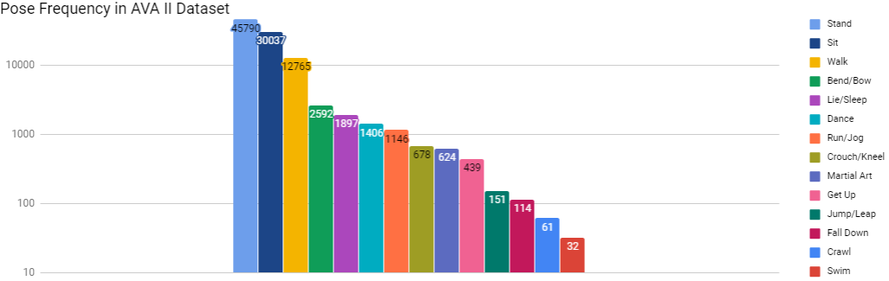
Introduction
Challenge:
Google current released version doesn’t contain object tracking. Using sequential model requires training a separate model to track object through time.
Our solution:
Extract frames in all videos, analyzing the actors’ poses in each image independently. More specifically, using residual network.
Reasons:
1. There are less consequences since no object will react upon target person’s poses.
2. Using static frames will significantly reduce the training time and no need for sequential model.

Slide 4
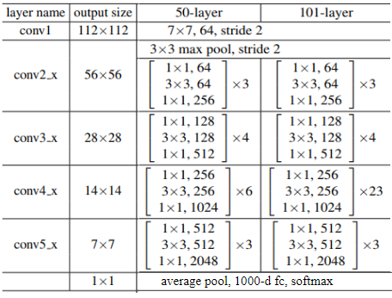
DNN architecture: ResNet-50, ResNet-101

Slide 5
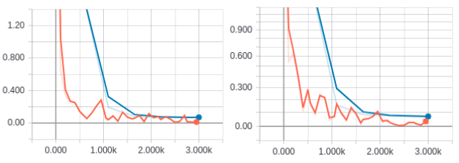
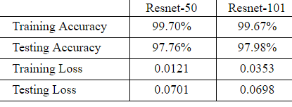
Model testing on MNIST
Learning rate: 0.001
Steps: 3000
Batch size: 100
Augmentation: No
Note: we keep the original structure of ResNet50 and ResNet101 when testing without fine-tuning. The result could be higher if the kernel size for the first CNN layer is 3*3 instead of 7*7 (image size is small)

Slide 6
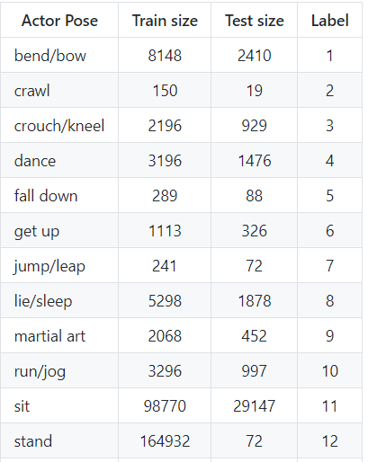

Selected dataset size
Reduce size of certain labels to balance the size and speed up training process.
Use image augmentation to reduce the impact of the small size label (overfit)

Slide 7
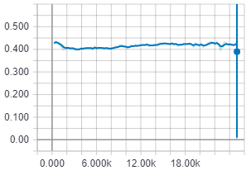
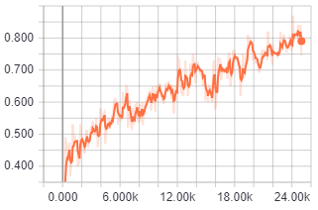
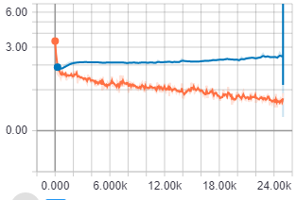
Result
Interpretation: The model stop learning at steps 1000 and starts to overfit the training data.
Hypothesis: our model has a worse generalization capability on labels that only have few data. The accuracy is 42% because certain labels have high accuracy
Learning rate: 0.00005
Steps: 10000
Batch size: 100
Augmentation: Yes
Test accuracy
Train accuracy
Train/test error

Slide 8
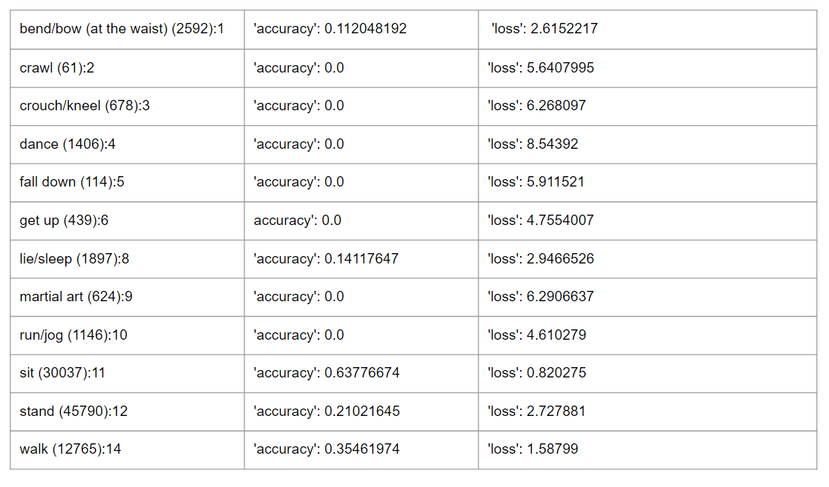
Analysis
Analysis
Since the imbalance distribution of data (corresponding to the frequency of actions happening in real life). Actions with larger number of training data have higher accuracy including stand sit walk.
However, actions sleep also have a good accuracy even with fewer data, which means our more is more suitable to this action.
But the final accuracy was not satisfiable, therefore, sequential model is more suitable for this task

Slide 9
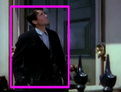

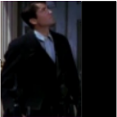
Successful case example
Corp
bounding box
Resize to
Square image
Resize to
224 * 224
ResNet-50
Stand
without
Keeping ratio
Another way we could choose:
Corp
bounding box
Resize to
Square image
Resize to
224 * 224
ResNet-50
?
by zero-padding to keep ratio

Slide 10
What we learnt
How to read csv file and convert images to numpy arrays before training.
Image augmentation can reduce the overfitness of the model
How to create model presented in a research paper. (not simple CNN, LSTM)
How to deal with the problem of ovefitness
How to reduce the memory needed during image preprocessing and training.
How to deal with the problem of unbalanced data for each label
Debugging skills such as whether correctly shuffled the data; whether extracted images has assigned a label correctly, why test accuracy doesn’t increase, etc.
What we could do differently:
Double check whether selected actor poses are correctly read from the csv file.
Carefully went through each released version of the dataset. (1.0, 2.0, 2.1)
Shuffle the data before training
Save Images into separate batch before training to increase loading speed.
Check the training/testing data size for each label before training.

Slide 11
Summary
We did: image selection, augmentation, then test our model on MNIST for debuging. At last, train it on target dataset and analyze.
Conclusion: The accuracy is not satisfiable. Analyzing video frames independently has its limitations. It’s recommended to use sequential models to to analyze sequence of video frames. We can verify our conclusion on HMDB in the future.

